Slide 1
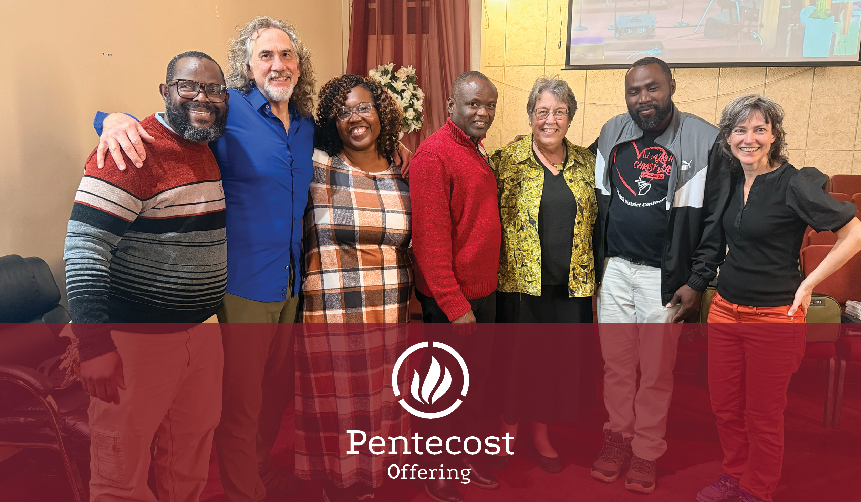


Slide 2

^{“All of them were filled}
^{with the Holy Spirit…”}
^{~ Acts 2:4}
^{Serving in the Spirit}

Slide 3

^{The Pentecost Offering of the}
Church of the Brethren highlights
^{how we serve through the power}
of the Holy Spirit as we call and
equip fearless disciples and leaders,
^{renew and plant churches,}
^{and transform communities.}
^{Give an offering today at}
^{www.brethren.org/giveoffering}
^{Scan with}
^{phone camera}

Slide 4
The Pentecost Offering supports Discipleship
and Leadership Formation which includes:
^{Intercultural Ministries}
^{L.E.A.D. Conference}
^{National Youth Conference}
^{Office of Ministry}
^{Young Adult Conference}
Thank you for giving generously!

Slide 5
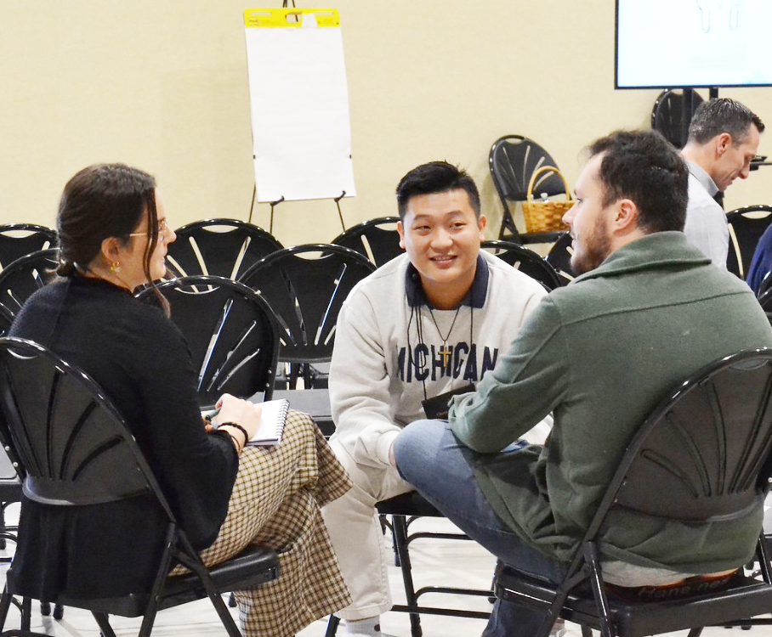
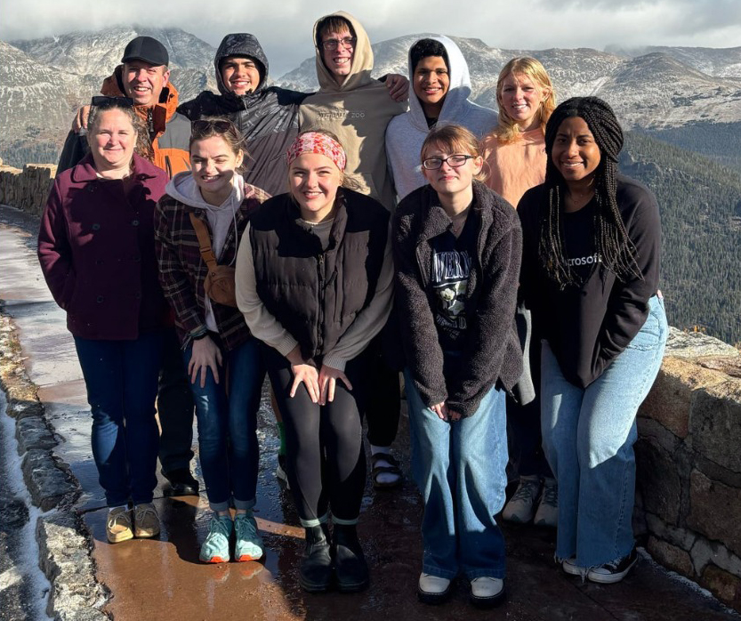
^{Your gifts do great things!}
^{www.brethren.org/}
^{greatthings}
Photos by Intercultural Ministries and Youth and Young Adult Ministries

