Slide 1
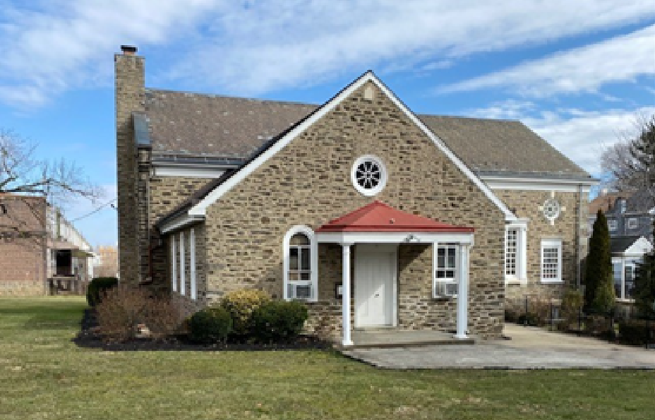
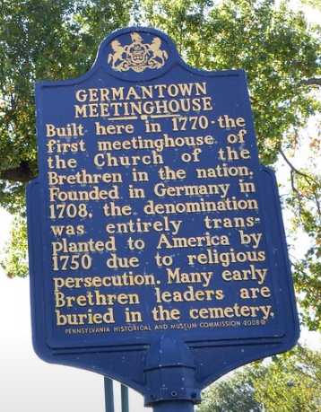
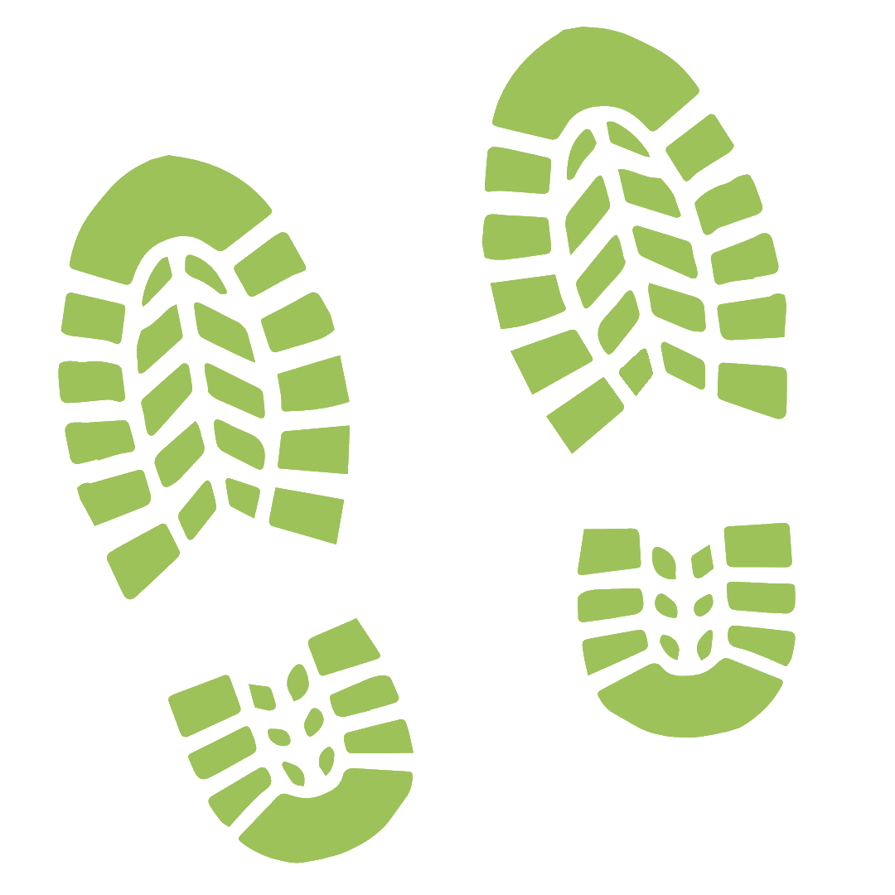
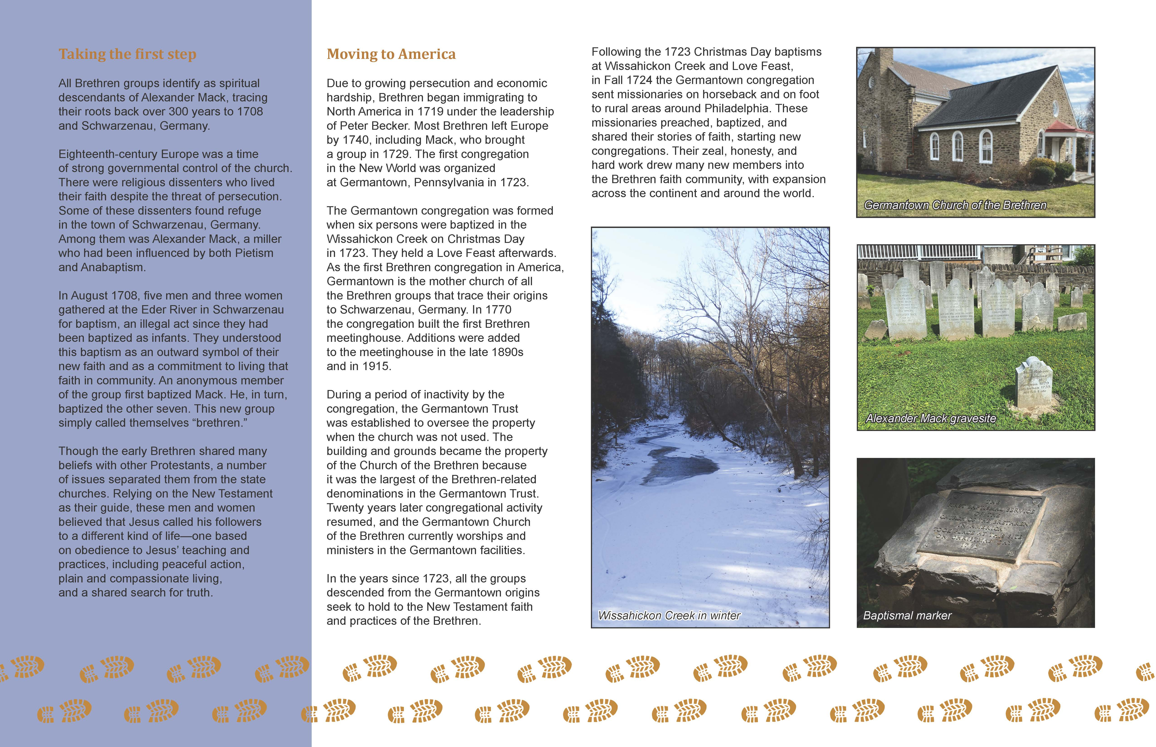
We walk
alongside
their footsteps
A Capital Campaign to
Preserve the Germantown,
Pennsylvania property
and the history of the
Church of the Brethren in America

Slide 5
