Slide 1



Slide 2

“Nobody hungry, nobody thirsty,
shade from the sun, shelter from
the wind, for the Compassionate
^{One guides them, takes them}
^{to the best springs.”}
^{~Isaiah 49:10, The Message}
^{Let love flow}

Slide 3
^{Give an offering today at}
^{www.brethren.org/giveoffering}

Slide 4
When you give to One Great Hour
^{of Sharing, you support:}
>Farmers participating in educational opportunities and
working to establish food security.
>Volunteers preparing for a year of Christ-like service.
>Brethren pastors, leaders, and members sharing in
meaningful conversations and events.
>Individuals encouraging people and
rebuilding homes affected by disaster.
Thank you for your generosity and for letting love flow!

Slide 5
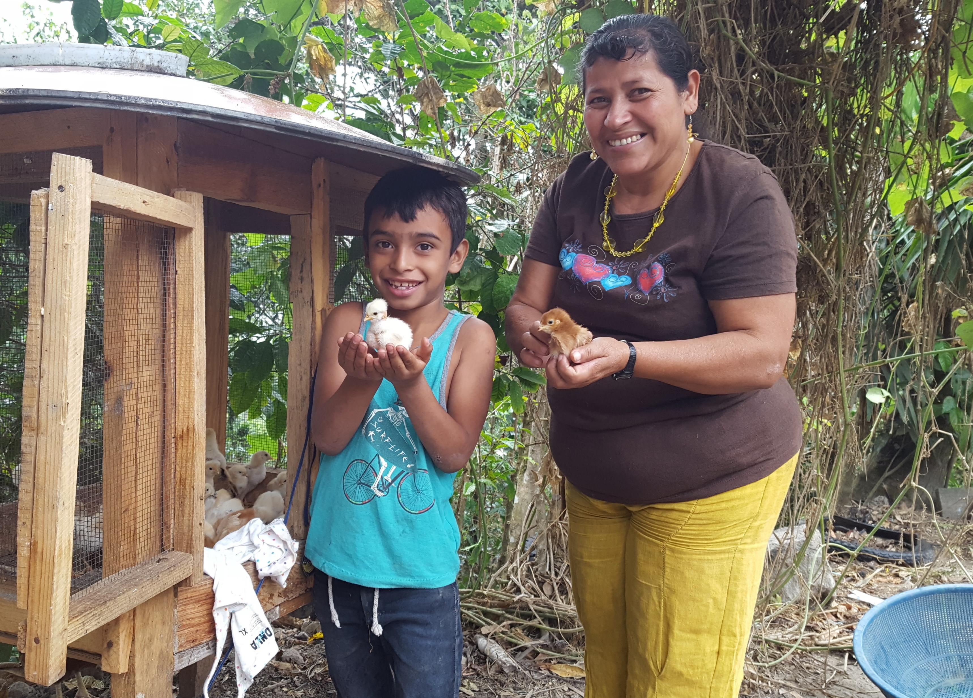
^{Your gifts do great things!}
^{www.brethren.org/greatthings}
Photos by Craig Thompson and Jeff Boshart

