Slide 1
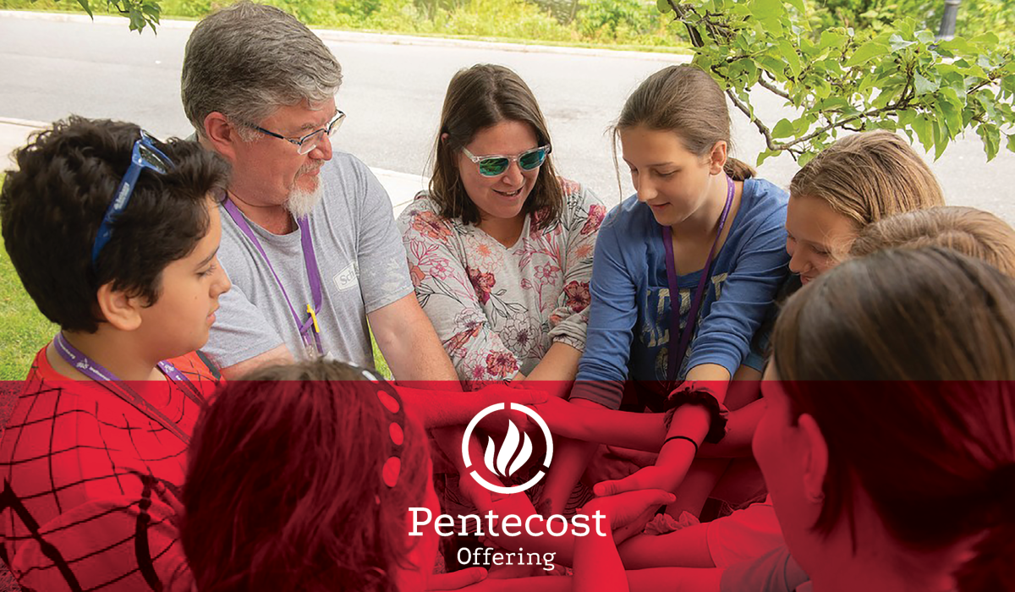


Slide 2

^{“He breathed on them and said,}
^{‘Receive the Holy Spirit.’”}
^{~John 20:22}
^{The gift of the Spirit}

Slide 3
The Pentecost Offering of the Church of the Brethren highlights our passion for calling and equipping fearless disciples and leaders, renewing and planting churches,
^{and transforming communities.}
^{Give an offering today at}
^{www.brethren.org/giveoffering}

Slide 4

^{Your gifts to the}
^{Pentecost Offering support:}
Discipleship Ministries providing support and resources to churches and pastors.
Intercultural Ministries building community through virtual platforms and resources.

Slide 5
Your gifts to the Pentecost Offering support (continued):
Youth and Young Adult Ministries hosting National Young Adult Conference online.
Office of Ministry finding new ways to connect
with districts and set-apart ministers.
Thank you for giving generously!

Slide 6
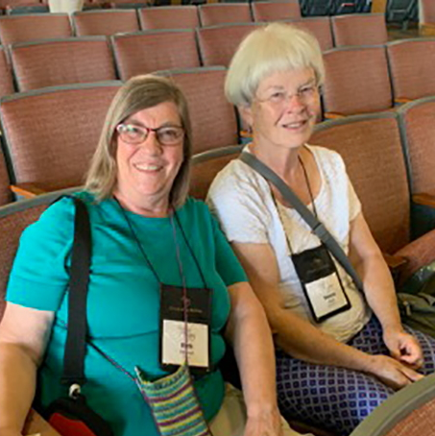
^{Your gifts do great things!}
^{www.brethren.org/greatthings}
Photos by Glenn Riegel and Ben Bear

